Slide 1

Energy Storage Systems

Slide 2
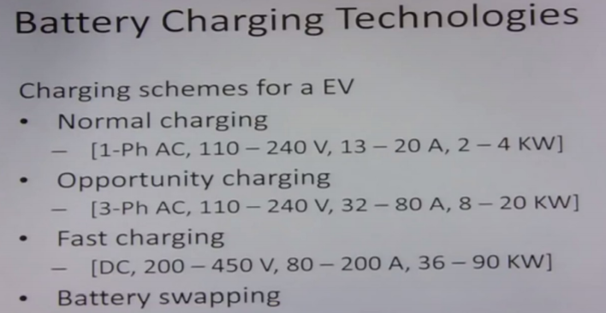

Slide 3
Battery charging technologies
Four major charging schemes: based on level voltage, current, power level, and the time of charging.
Normal charging- single phase AC system, voltage -110 to 240 volts. Currents -13 Amps to 20 Amps, -2 to 4 KW(homes, garages, and residential car parking),
takes a longer time, typically 5 to 8 hours and it is done mostly in the night time
Since the current is less and also it is done in night time, it does not burden the power system
on the other hand it helps the power system for load leveling, since the other loads are very less
--not very popular among customers, wants quick charging
opportunity charging-- uses 3 phase AC , voltage of 110 to 240 volts current --32-80 Amps, power range of 8 to 20 KW
Charging can be done anywhere public charging stn/ public parking
Since its intermittent charging, does not put stress on power system

Slide 4
Fast charging -DC system ,voltage - 200 volts to 450 volts current- 80 to 200 Amps, power -36 to 90 KW
It is a fast charging algorithm and it charges the battery by direct DC voltage system charges the battery in 20 to 30 minutes and the battery reaches typically 80% of its full charge capacity in the 30 minutes
Needs heavy charging platform, it requires a dedicated charging stations and dedicated hardware and safety protections in place
Also since this is a heavy system, it puts burden on the power system and it has to be designed and installed in concentration with the utility

Slide 5
Battery swapping–
Not actual charging, just swapping the batteries at the charging station
Advantages:
Time-5 to 10
Discharged batteries taken by the charging stations & charged during the night time
Doesn’t put any stress on power system, rather it helps it drawback :
Requires a very large space for the charging starting to mechanically swap the batteries
Requires standardization of the battery packs

Slide 6
Charging Algorithms:
Improve the charging efficiency
Reduce charging time
Enhancing the battery life
Protect the battery

Slide 7
Charging algorithms:
Constant current charging (CC)
Constant voltage charging (CV)
Constant current Constant voltage charging
(CCCV)
Multistage charging (MSC)
Pulse charging
Trickle charging(TC)

Slide 8
Constant current charging (CC)
It charges the battery at constant current
It is a very simple algorithm (nickel cadmium and nickel metal hydride batteries)
Higher the amount of current used to charge the battery, the charging time will be correspondingly less. But this comes at a cost of charging efficiency and vive versa
Optimum current level is maintained such that the charging efficiency is optimum, together with not allowing the battery temperature to go up
So the end of this charging process is decided based on the voltage level.
Once the battery is charged to its full capacity, the battery voltage will start dropping rather than increasing, so that decides that this charging needs to be stopped
Charging algorithm requires
Current sensor for controlling the current,
Voltage sensor for stopping the charging, and
Temperature sensor for thermal protection.

Slide 9
Constant voltage charging (CV)
It is a constant voltage system based charging, but in this current is limited
Has charging scheme, which tells the maximum amount of current that can be allowed to charge the battery
Battery charges and it attains its full capacity
Current taken by the battery becomes lesser and lesser and it becomes almost constant and very low magnitude current flows when battery reaches its full capacity
So the constant small current will last for around three hours before the system can be stopped

Slide 10
Constant current Constant voltage charging (CCCV)
This is a hybrid charging algorithm
It has advantage of constant current and constant voltage charging both
To charge the battery quickly, charging process at start will be CC.
In this scheme, the charging starts in constant current mode and when the voltage or the charge level reaches a threshold, it moves to constant voltage charging.
Under constant voltage charging, the current magnitude is relatively less and it will charge from 80% to the full capacity at very small current magnitude
Charging scheme is used in lead acid batteries and lithium ion batteries.

Slide 11
Multistage charging scheme(MSC)
Charging takes place in various stages
This charging gives variable magnitude of current at different stages of charging
It starts with high current magnitude and the magnitude of current decreases as the charge of the battery increases
When the battery is reaching its full capacity, the requirement of current becomes less
It’s a kind of variable current magnitude, which is progressively decreasing from starting towards the end of charging
popular in charigng lithium ion batteries.

Slide 12
Pulse charging/ Trickle charging
Pulse charging is very similar to multistage charging
It is done in pulses. It gives pulses of current in decreasing fashion.
It starts with a high current pulse followed by the current pulse of lower magnitude
Trickle charging is basically a charging done to keep the battery in charged condition. So once the battery is fully charged and if we left it unattended, it will discharge because of self charging and other losses
This kind of charging enables keeping the battery in fully charged condition and supplying only the losses, which occur due to self discharge.

